Slide 1

Databases
Intro to Computer Science
Spring 2018

Slide 2
Why do I need a database?
Consider these problems:
1) Storing data in your program variables
What if you have a lot of data? Your program will get slow
2) Storing data in files
What if multiple people/programs need to access them?
3) Concurrent read/writes
What if multiple people/programs are trying to read/write the data?

Slide 3
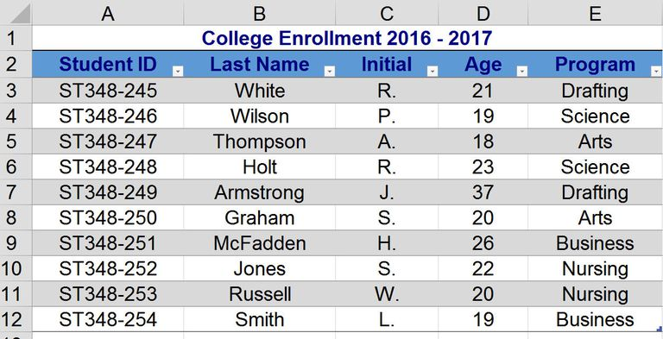
What is a database?

Slide 4




What is a database?
Similar to Excel Spreadsheets but more powerful
Databases allow you to organize data in a way that is efficient, scalable, accessible, and reliable.
Here are some of the most popular ones:

Slide 5
What is a database?
Relational databases allow for entity relationships.
NoSQL databases do not have relationships. They are designed to handle flexible/unstructured data models.

Slide 6

Anatomy of a database
Main Structures
Database
Tables
Columns
Rows

Slide 7
Anatomy of a database
A database consists of “tables” dedicated to entities and relationships. Here is an example of a university database:
Student
n_number
net_id
name
dob
address
Course
course_code
room
time
day
Instructor
instructor_id
name
dob
address
salary
takes
teaches

Slide 8
Anatomy of a database
Each table contains columns that represents attributes of the entity or relationship. Columns can contain text, integers, etc.
Every table must have a primary key, which uniquely identifies each row in the table (there cannot be duplicate primary keys).
Foreign keys refer to the primary keys of another table. These are used to represent relationships between tables/entities.

Slide 9
Table Example
The students table:
The takes table:
n_number | net_id | name | dob | address
N12345678 | abc123 | Abigail Carter | 01/23/01 | 1 Apple Street
N87654321 | foo654 | Frederico Lee | 12/30/99 | 420 Green Ave
id | course_id | n_number
1 | CS 1122 | N12345678
2 | CS 1122 | N87654321

Slide 10
Redundancy
One of the primary goals of database design is to reduce redundancy as much as possible.
There should be no columns unrelated to the entity or relationship in a table. Put it in its own table.
n_number | net_id | name | dob | address | course
N12345678 | abc123 | Abigail Carter | 01/23/01 | 1 Apple Street | CS 1122
N87654321 | foo654 | Frederico Lee | 12/30/99 | 420 Green Ave | CS 1114

Slide 11
Redundancy
Don’t put the same data in multiple places!
This can cause problems when you need to delete or update.
n_number | net_id | name | dob | address
N12345678 | abc123 | Abigail Carter | 01/23/01 | 1 Apple Street
N87654321 | foo654 | Frederico Lee | 12/30/99 | 420 Green Ave
id | course_id | n_number | name
1 | CS 1122 | N12345678 | Abigail Carter
2 | CS 1122 | N87654321 | Frederico Lee

Slide 12
Database Normalization
Processes for restructuring database to reduce redundancy
First Normal Form (1NF)
Second Normal Form (2NF)
Third Normal Form (3NF)
Boyce-Codd Normal Form (BCNF)
And lots more!

Slide 13
Structured Query Language (SQL)
Language used to talk with databases
Human readable
● Literally query strings sent to the server
Used everywhere
● Basically any website that stores data
Different servers implement slightly different dialects
● MySQL is most common and what we’ll be focusing on
● “Core functionality” is defined in SQL-99

Slide 14
SQL (cont)
SELECT net_id, name FROM students WHERE name LIKE ’A%’;
Gets the Net ID and name of all rows where the name starts with “A”
Case insensitive by default
Capitalization of SELECT, FROM, WHERE, LIKE doesn’t matter

Slide 15
SQL (cont)
SQL statements are typically performed “in the context”
of a specific DB
This is set usually set at connect time or with USE <db_name> statement
Queries can access all databases the connecting user has access to though
SELECT name FROM university.students WHERE net_id = ‘abc123’;

Slide 16
SQL (cont)
SELECTs can also select constants or functions
SELECT 9, COUNT(*) FROM instructors;
Some built in functions:
DATABASE()
VERSION()
AVG()
SLEEP()

Slide 17
SQL (cont)
Subqueries:
SELECT course_id FROM teaches WHERE instructor_id = (SELECT instructor_id FROM instructors WHERE name=’Nasir Memon’);
Selects the instructor ID that matches the name Nasir Memon.
Then uses that to find the course_id that he teaches.

Slide 18
SQL (cont)
Miscellaneous:
SQL comments are “--”
Semi-colons are optional, except in the CLI
MySQL runs on port 3306

Slide 19
SQL (cont)
Creating tables:
CREATE TABLE students(
n_number VARCHAR(32),
net_id VARCHAR(8),
name VARCHAR(64),
dob DATE,
address TEXT
PRIMARY KEY (n_number) );

Slide 20
MySQL CRUD
Create: INSERT INTO table_name(column_name,...) VALUES(val,...);
Read: SELECT column_name,... FROM table_name;
Update: UPDATE table_name SET column_name = value;
Delete: DELETE FROM table_name WHERE column_name = value;

Slide 21
Connecting the database to your application
The PyMySQL library
import pymysql.cursors
# Connect to the database
connection = pymysql.connect(host='localhost',
user='user',
password='passwd',
db='db_name')

Slide 22
Connecting the database to your application
Running an SQL statement
try:
with connection.cursor() as cursor:
sql = "INSERT INTO `students` (`net_id`, `name`) VALUES (%s, %s)"
cursor.execute(sql, ('nyu999', 'Andy Hamilton'))
connection.commit()
with connection.cursor() as cursor:
sql = "SELECT `net_id`, `name` FROM `students` WHERE `net_id`=%s"
cursor.execute(sql, ('nyu999',))
result = cursor.fetchone()
print(result)
finally:
connection.close()

Slide 23
DEMO

